Slide 1
The Origin of Species

Slide 2
I. Species: A functional defintion
a) Biological Species Concept:
1. A population or group of organisms whose members have the potential to interbreed with one another in nature to produce fertile offspring.
II. Reproductive Isolating Mechanisms: Prezygotic and Postzygotic Barriers
A reproductive isolating mechanism is a structural, functional, or behavioral characteristic that prevents successful reproduction from occurring.
a) Prezygotic Barriers
1. Impede mating between species or hinder fertilization of the ova.
Habitat Isolation – same geographical area but different locations.
Behavioral Isolation – different mating rituals.
Temporal Isolation – different breeding times.
Mechanical isolation – different or incompatible reproductive structures

Slide 3
b) Postzygotic Barriers are the result of developmental or physiological differences between the members of two species after mating.
1. Gamete isolation is the physical or chemical incompatibility of gametes of two different species.
An egg may have receptors only for the sperm of its own species.
If the gametes lack receptors to facilitate fusion, they cannot form a zygote.
2. Zygote mortality is a mechanism that works when hybrids (offspring of parents of two different species) do not live to reproduce.
Hybrid sterility occurs when the hybrid offspring are sterile (e.g., mules).

Slide 4
III. Speciation: When are two populations new species?
a) When populations no longer interbreed they are thought to be separate species.
1. As populations diverge, they form similar but related species.
2. As natural selection adapts populations occupying different environments, they will diverge into races, subspecies, and finally separate species.
3. Genetic divergence results when adaptation, drift and mutation act on populations.
4. Barriers to gene flow between populations isolate those populations, ultimately leading to the formation of new and separate species.

Slide 5
.
b) Types of Speciation
1. Allopatric Speciation
Populations begin to diverge when gene flow between them is restricted.
Geographic isolation is often the first step in allopatric speciation.
Other mechanisms may develop that further restrict reproduction between populations: these are the reproductive isolating mechanisms.
2. Sympatric Speciation
Sympatric speciation happens when members of a population develop some genetic difference that prevents them from reproducing with the parent type.
This mechanism is best understood in plants, where failure to reduce chromosome number results in polyploid plants that reproduce successfully only with other polyploids.
Reproduction with their parent population (the diploids) produces sterile offspring.

Slide 6
Polyploidy and hybridization are important sympatric speciation mechanisms in plants.
Whereas animals tend to be unisexual, plants often have both sexes functional in the same individual.
Consequently, plants can (if they lack a self incompatability mechanism) reproduce with themselves (both sexually and asexually), establishing a reproductively isolated species very rapidly.

Slide 7
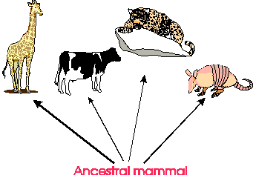
IV. EVOUTIONARY PATTERNS
Divergent, Convergent, and Parallel Evolution
a) Divergence occurs when one species evolves into two (or more) species, which continue to change over time and become less and less alike.
1. As time goes on and more divergence occurs of these related forms (with a common ancestry), we say that adaptive radiation has occurred.

Slide 8
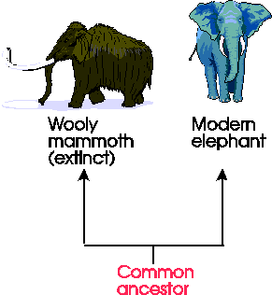
b) Parallel Evolution also involves divergence from a common ancestor.
However, the descendants evolve similar morphologic characteristics as time goes on (most likely in response to similar environmental parameters, i.e., occupying a similar niche).
So, parallel evolution is the development of similar characteristics in closely related organisms.

Slide 9
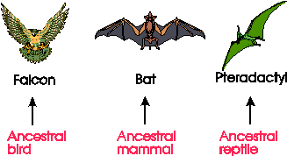
c) Convergent Evolution is the development of similar morphology in distantly related groups.
As with parallel evolution, this is in response to adapting to similar habitats and niches.
An excellent example of this is the modern dolphin and the ichthyosaurs of the Mesozoic Era.

Slide 10
V. EVOLUTIONARY TRENDS
a) An increase or decrease in size.
This may be for the whole body or certain parts (such as teeth, brain, horns, etc.).
b) A reduction or increase in the number of certain body parts, such as ribs, toes, fingers, teeth, etc.
c) An increase in the complexity of certain body parts, such as brain, armor (dinosaurs), etc.
NOTE: Some organisms did not change much over very long periods of time. Ones that are still living (extant) are called living fossils (examples: the brachipod Lingula, the opossum, the coelocanth (Latemeria).

Slide 11
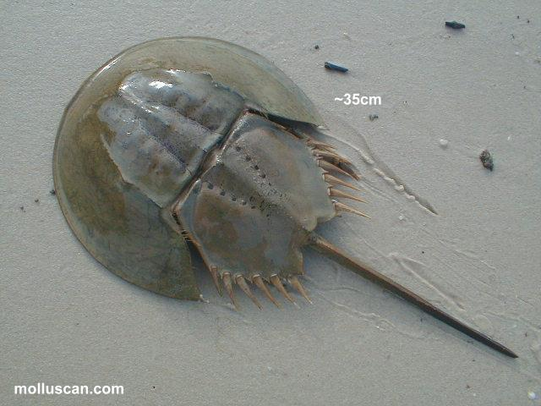
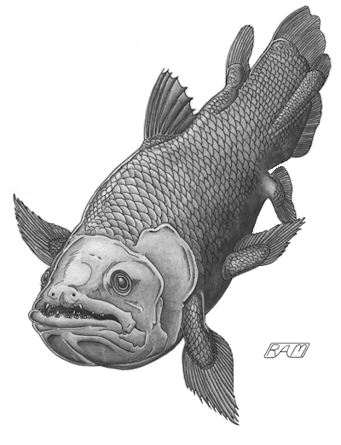
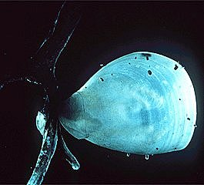
Horseshoe Crab
Coelocanth
Brachiopod

Slide 12
VII. DETERMINING PHYLOGENETIC RELATIONSHIPS (CLADISTICS AND CLADOGRAMS)
a) PHYLOGENY: The history of descent of organisms which is based upon taxonomy and evolution.
b) The establishment of a hierarchy based upon comparative anatomy and biochemistry is valuable in indicating the relatedness between organisms.
c) Cladograms are branching diagrams to show a hierarchical distribution of shared characters.
Phylogenies are determined by constructing cladograms.
Each branch (or bundle of branches) of a phylogeny is called a clade (from "clados" meaning branch).

Slide 13
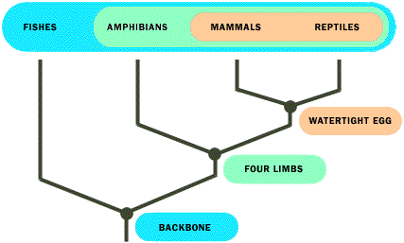
d) A divergence is a split on a cladogram. Convergence is the evolution of similar features in two unrelated (or distantly related) clades.
e) The manner in which organisms are related is defined as their phylogenetic relationships (or evolutionary relationships).
Cladogram showing the phylogenetic relationships of vertebrates
(From: American Museum of Natural History: Understanding Cladistics at http://www.amnh.org/Exhibition/Fossil_Halls/cladistics.html).

